Slide 1
I.T Support Ticket Analysis
Presented by S. Shiva Kumar Yadav
Date: 25/11/2024

Slide 2
I.T Support
The IT Support role is a critical function in any organization, responsible for ensuring the smooth operation of technology systems, resolving technical issues, and assisting users with hardware, software, and network-related problems.

Slide 3
Key Responsibilities of I.T Agents
Technical Troubleshooting
System Maintenance
User Assistance
Monitoring and Reporting
Escalation Management

Slide 4



Analytical Approach
Data cleaning: Utilized functions like TRIM, CLEAN, and Remove Duplicates to ensure data accuracy.
Data Enrichment: Enhanced the dataset with additional variables using VLOOKUP to cross-reference external data sources.
Descriptive Analysis: Used Pivot Tables for summarizing key metrics and identifying Tickets patterns across the Categories.
Trend Analysis: Conducted Time series analysis using TREND and FORECAST functions to predict the ticket volumes for the upcoming years.
Visualization: Created dynamic charts and dashboards for data representation, enabling interactive data exploration.

Slide 5
As you can see the graph of Year vs Volume of Tickets, The Volume of Tickets are increasing Year by Year.
Considering this for the Upcoming years, we need to hire more agents for handling the Tickets.

Slide 6
Coefficient of Severity VS Resolution Time (Days)
Checked the Relation between the Severity of Tickets and Resolution time(Days).
The Coefficient Value is Negative i.e.,(-0.040536349 )
Whenever the Coefficient value is Negative then both are inversely proportional to each other.
Severity of the Tickets is inversely proportional to the Resolution Time(days).
When the Severity of the Tickets increases, then Resolution Time Decreases.
When Resolution Time increases, then the Severity of the Tickets decreases.

Slide 7
Based on this graph, we can say the tickets tagged as Urgent have Resolution Time(Days) less compared to others.
For the Ticket Category Normal, Resolution Time (Days) is more compared to others.
We need to Target the Normal Ticket Category Request to reduce the Resolution Time.

Slide 8
As you can see in the above Graph, we can observe that the Ticket Category which having Hardware and System, had the Avg. Resolution Time(Days) more compared to other categories.
So, if there is any investment then invest more in these categories(Hardware, System). It eventually reduces the Resolution Time.

Slide 9
Coefficient of Customer Satisfaction VS Resolution Time(Days)
Checked the Relation between customer satisfaction and resolution time(Days).
The Coefficient Value is Negative i.e.,(-0.003623335 ).
Whenever the Coefficient is Negative then both are inversely proportional to each other.
Customer Satisfaction is inversely proportional to Resolution Time(days).
Customer Satisfaction increases, then Resolution Time Decreases.
Resolution Time increases, then Customer Satisfaction decreases.

Slide 10
The Average Satisfaction Rate is increasing year by year, which is a very good thing.
There is still more room to increase the Satisfaction Rate.

Slide 11
As you can see in the above graph Age vs Count of Tickets. For some ages, 42,44 and 28 are doing more tickets than the other ages.
There is no proper distribution of Tickets among the agents.
A proper distribution of Tickets is needed to increase Customer Satisfaction and Decrease the Resolution Time.

Slide 12
Row Labels | Training Required
A. Trejo | Yes
Alberto Casillas | NO
Alberto Gastelum | NO
Aldo Carrillo | Yes
Alfonso Barraza | Yes
Alfredo Barreras | NO
Armando Sierra | NO
Aurelio Tanori | NO
Barbara Grijalva | NO
Barraza Alberto | NO
Darwin E. | NO
Diana Rojo | NO
Eduardo Luna | NO
Elena Velez | Yes
Enrique Montiel | NO
Estuardo Ocaño | Yes
EstuardoTorres | Yes
Eva Cardenas | NO
Flores Sierra | Yes
Galindo Guadalupe | NO
Griselda Galindo | NO
Guadalupe Hernandez | NO
Guadalupe Torrico | NO
Guadalupe Villanueva | Yes
Isela Leyva | NO
Javier D. | NO
Jesus Contreras | NO
Jesus Pacheco | Yes
JesusGrajeda | NO
Leon Lourdes | NO
Lopez Moran. | Yes
Lorena | Yes
Luis Arguello | NO
Luis Torres | NO
Marisol Piedrahita | NO
Mata Lucero | NO
Melinda | NO
Miller Gaviria | Yes
Nurio Zepeda | Yes
Orci Carlos | NO
Parra Luna | Yes
Ramon Macias | NO
Reyna Santacruz | NO
Rosa Olguin | NO
Sandra Lujan | Yes
Segura Garcia | NO
Silvia Morales | NO
Velasquez Jose | NO
Willyberto Gonzales | NO
Yomaira Agudelo | NO
For some of the agents, training is required to perform better and produce quality outputs.
Marked them as yes based on the above-average resolution time and below-average customer satisfaction.

Slide 13
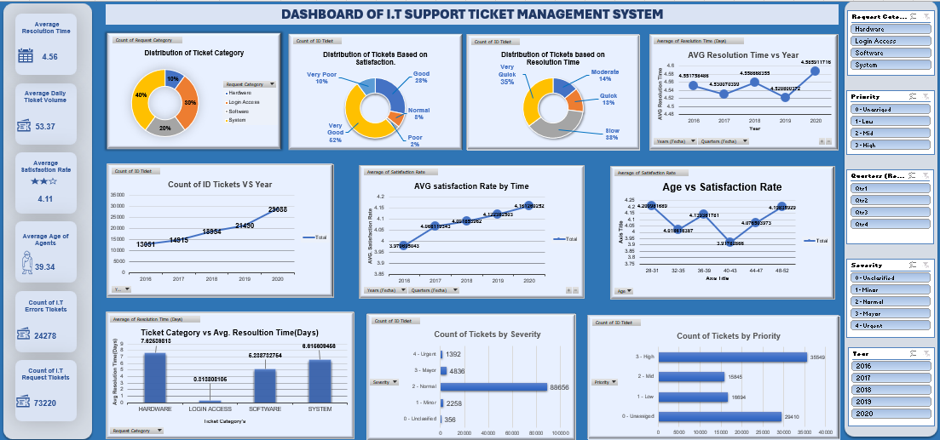
Dashboard

Slide 14
Conclusion
The Count of Tickets increasing year by year. So we need to Hire more Agents for the upcoming years.
For some of the Agents Training is required, we can invest in training if there is any to get better output results and performance.
The Satisfaction and Resolution Time are inversely proportional to each other. Lower the Resolution Time better the Satisfaction.
For Normal Severity Ticket Category Request should be concentrated, As it has a Higher resolution time.
For Ticket Category Hardware and system also have a Higher Resolution Time. We should Invest in this category to reduce the Resolution Time.

Slide 15
Thank you
S. Shiva Kumar Yadav
Date: 09-02-2024

